Slide 1
Lagrange Multiplier

Slide 2



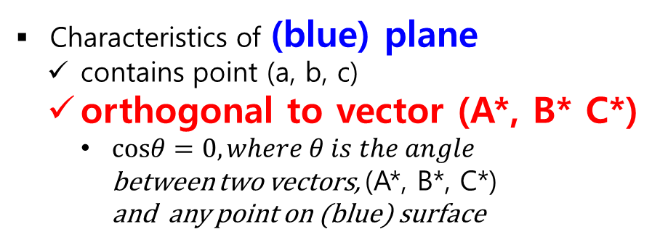

Prerequisite
Orthogonal Plane
$$z$$
(A, B, C)
Characteristics of (blue) plane
contains point (a, b, c)
orthogonal to vector (A*, B* C*)
$cosθ=0, where θ is the angle$ between two vectors, (A*, B*, C*) and any point on (blue) surface
(A*, B*, C*)
$$θ={90°}^{ }$$
=(A, B, C) - (a,b,c)
(a, b, c)
$$x$$
$$y$$

Slide 3

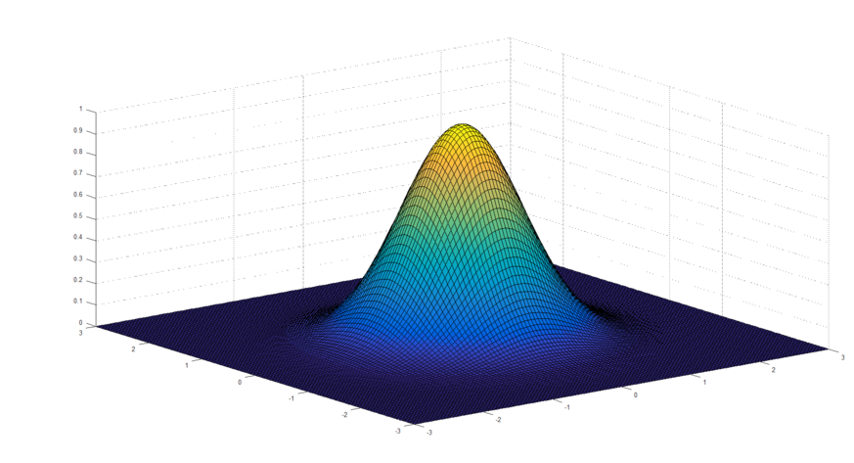
Prerequisite
When gradients are 0, value is maximized (or minimized)
https://blog.naver.com/lyb0684/221332307807

Slide 4
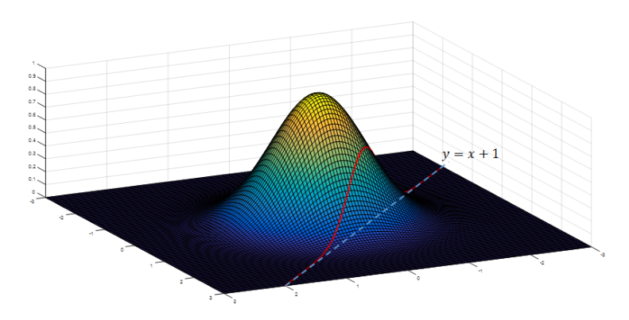
Question
Find maximum (or minimum) value of f(x) with constraint g(x) = 0
Constraint g(x) = 0
g(x) = y-x-1 = 0
this line contains all values of z axis
So this line (plane) has orthogonal (red) vector
Plain 이 orthogonal 한 것과
Plain 의 gradient 가 orthogonal vector 라는 것이
연결이 안됨
https://blog.naver.com/lyb0684/221332307807

Slide 5


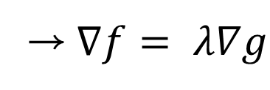
Lagrange Multiplier
"Maximizing (or Minimizing) f(x) with constraint g(x) = 0" is satisfied when two vectors of f(x) and g(x) has equilibrium power
Gradient Vector that maximize f(x)
$$∇f−λ∇g=0$$
→$∇f= λ∇g$
Therefore, we should satisfy all these equations
Orthogonal Vectors of plane
Bussotti, P. (2003). On the genesis of the Lagrange multipliers. Journal of optimization theory and applications, 117(3), 453-459.

Slide 6
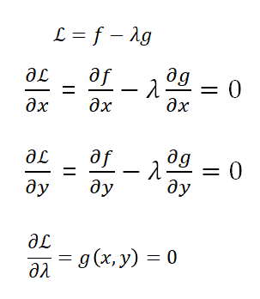

Lagrange Multiplier
"Maximizing (or Minimizing) f(x) with constraint g(x) = 0" is satisfied when two vectors of f(x) and g(x) has equilibrium power
Lagrange formulates problem as belows:
$$∇f−λ∇g=0$$
→$∇f= λ∇g$
Therefore, we should satisfy all this equations
https://blog.naver.com/lyb0684/221332307807

Slide 7
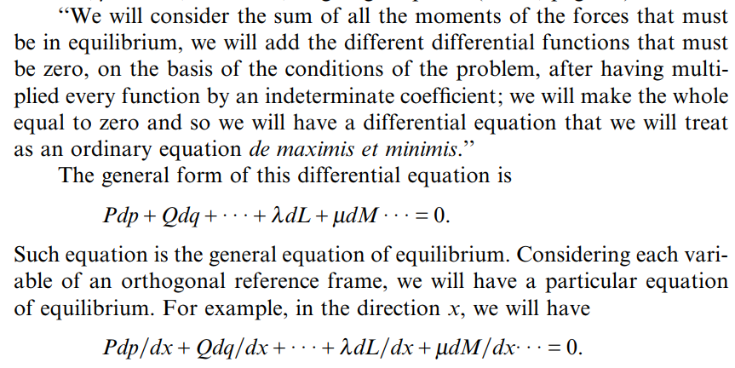
Further Constrains
더 이해해서 시각적으로 표현이 되면 좋을 듯
Bussotti, P. (2003). On the genesis of the Lagrange multipliers. Journal of optimization theory and applications, 117(3), 453-459.

Slide 8
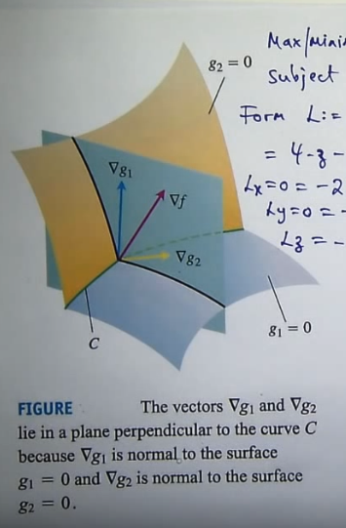
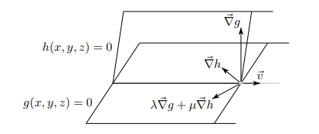
f의 gradient 는 두 Tangent Plane 이 만나는 곳인 직선 벡터 v 와 직교해야 함
그러려면 h, g 의 법선 벡터의 합과 평행해야 함
2) 각각의 Tangent Plane 과 평행해야 함 ... ?
http://www.math.ubc.ca/~feldman/m226/multiLagrange.pdf
http://www.math.ubc.ca/~feldman/m226/multiLagrange.pdf

